Slide 1
MQTT Device Description
Bachelor Thesis
Adrian Bärtschi

Slide 2

Notes:
http://visualizetheweb.com/wp-content/uploads/2014/12/IoT.png

Slide 3
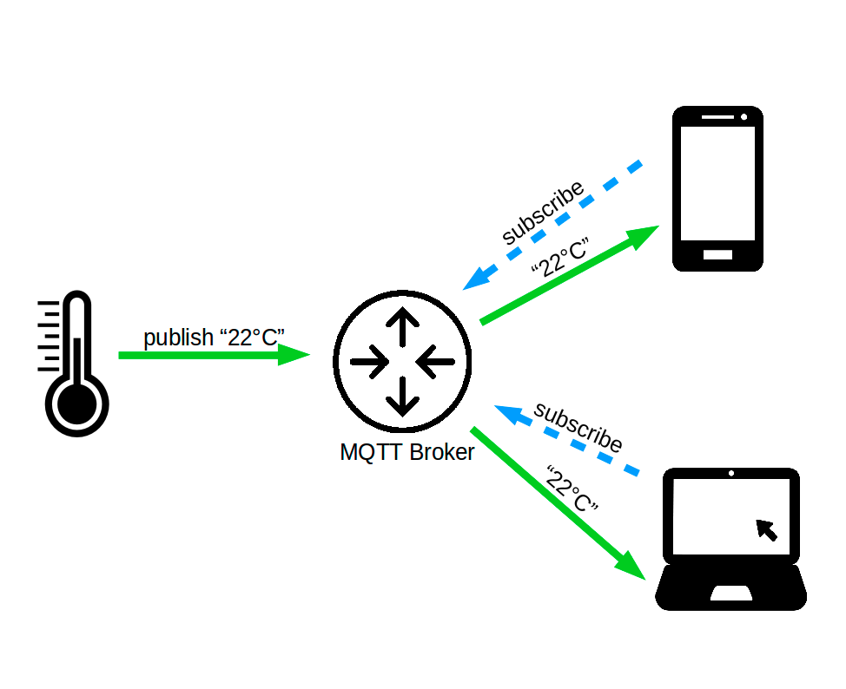
MQTT
Constrained Devices
Publish/Subscribe
Topics

Slide 4
Problem
Keine Topic Discovery
“home/livingroom/getTemp” ?
“home/temperatur/livingroom?”
“home/sensor1/temp” ?
...

Slide 5
Problem
Keine Topic Discovery
Payload Encoding
02dc990 696c 6e65 2f74 716d 7474 3376 492f 714d
02dc9a0 7474 6341 6974 6e6f 694c 7473 6e65 7265
02dc9b0 632e 616c 7373 4b50 0201 0314 000a 0000
02dc9c0 0008 3920 4652 a66e b98c 1af9 0000 4b7a
02dca30 01be 0000 0034 0000 0000 0000 0000 0000
02dc990 696c 6e65 2f74 716d 7474 3376 492f 714d
02dc9a0 7474 6341 6974 6e6f 694c 7473 6e65 7265
02dc9b0 632e 616c 7373 4b50 0201 0314 000a 0000

Slide 6
Problem
Keine Topic Discovery
Payload Encoding
Message Interpretation
{
“value”: 22.3
}
Notes:
Semantik

Slide 7
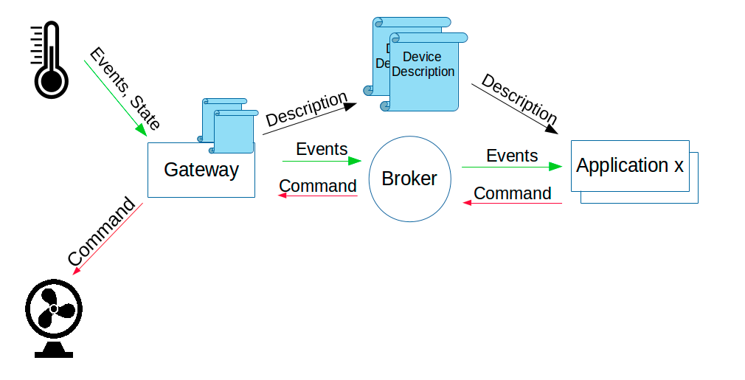
Lösung

Slide 8
Device Description
State
Events
Commands
YAML / JSON
id: "IoT-Humidity Sensor"
description: "The Humidity sensor can be used to measure relative humidity."
stateDescription:
states:
- name: "HumidityInterval"
range:
min: 0
max: 9223372036854775807
type: "Long"
description: "Interval of the measurements in ms."
eventDescription:
events:
- name: "Humidity"
range:
min: 0.0
max: 100.0
type: "Double"
description: "Relative Humidity in percent"
commandDescription:
commands:
- name: "SetInterval"
linkedState: "HumidityInterval"
description: "Set the measurement interval of the sensor, 0 disables the measurements"
parameter:
Interval:
min: 0
max: 9223372036854775807
type: "Long"

Slide 9
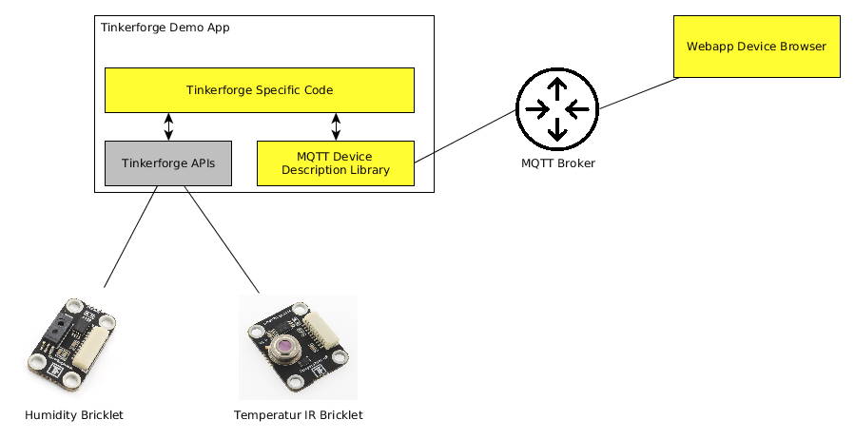
Umsetzung

Slide 10
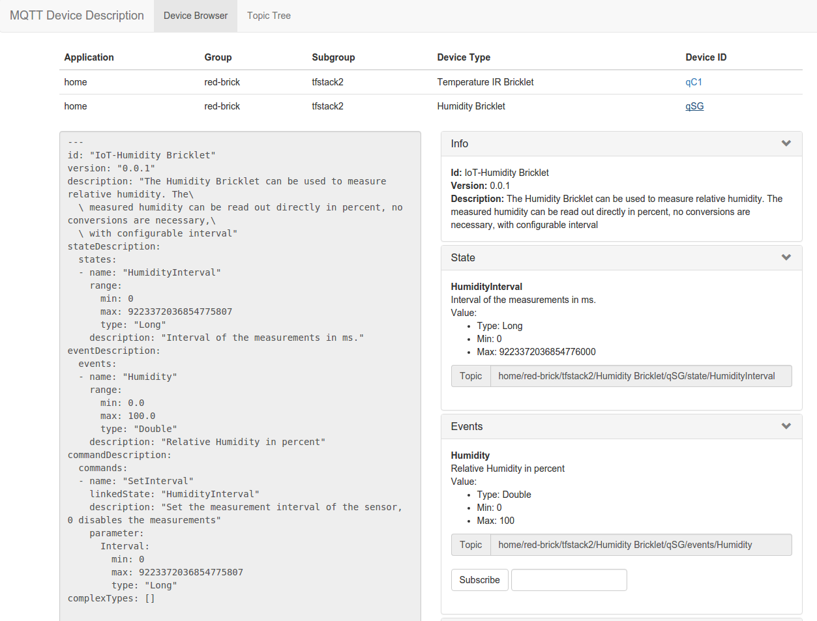

Slide 11
Fazit
Viel neu, wenig Erfahrungen
Funktionierendes Konzept
Implementation an System in Praxis

Slide 12
Vielen Dank

